Slide 1
Smart AI Food Scanner For Real-Time Nutritional Analysis
Guided by, MS. Gayathri Asst. Professor,
CSE (AI & ML) Department
Presented by,
Akshay Krishna k(NCE22AM003) Dhanush P(NCE22AM015)
Krisna Dev T A (NCE22AM025) Rohini M V(NCE22AM039)

Slide 2
Introduction
This is used AI to scan food and find its nutritional values in real time.
It helps users know calories, vitamins, and other nutrients easily.
The system gives health tips and diet suggestions based on user needs.
It supports healthy eating habits and helps in personal health tracking.

Slide 3
Objective
To develop an intelligent system that detects food items using AI-based image processing.
To analyze and display real-time nutritional information such as calories, fat, and protein.
To provide personalized health and diet recommendations for users.
To store and track daily food intake for better health monitoring.
To promote smart and healthy eating habits through technology.

Slide 4
Abstract
To design an AI-based food scanning system for identifying food items.
To perform real-time nutritional analysis using smart image processing.
To provide user-friendly results and personalized health suggestions.
Show calories, fat, protein, and vitamins instantly.
Suggest healthy food options based on user needs.
Give alerts or reminders for maintaining balanced diet habits.

Slide 5
Abstract
Uses AI + Image Processing + Machine Learning to detect and analyze food items in real time.
Identification
Analysis
Recommendation
Tracking
Goal: Develop a smart system that helps users maintain a balanced and healthy diet through real-time nutritional analysis.
Benefits: Encourages healthy eating, saves time, improves food awareness, and supports personal health tracking.

Slide 6
Problem Statement
Manual tracking of calories and nutrients in meals is often inaccurate and time-consuming.
Users lack a simple way to identify nutritional content in real-time.
Existing food analysis methods rely on generic databases and fail to account for portion size or preparation method.
Need for a reliable ,AI-powered system that provides instant, personalized nutritional insights.

Slide 7
Tooles & Libraries used
Python – Backend & AI processing.
Node.js + React.js – Frontend & API development.
Selenium – Web scraping.
spaCy– NLP tasks.
scikit-learn – classification models.
MongoDB – NoSQL database.
Flask / FastAPI – API layer.
Render / Vercel – Cloud deployment.

Slide 8
Literature Review – NutrifyAi
Paper name: NutrifyAi:An AI-Powered System for Real-Time Food Detection, Nutritional Analysis, and Personalized Meal Recommendations.
Authors: Michelle Han, Junyao Chen, Zhengyuan Zhou.
Published: August 2024.
Method: Combines YOLOv8 for food detection, Edamam APIs for nutrient analysis, and personalized meal recommendations.
How It Works: Users capture food images; the system identifies the food, analyzes its nutritional content, and suggests personalized meal plans.
Advantages: Real-time analysis, user-friendly interface, and personalized dietary guidance.

Slide 9
Literature Review – FoodViser
Paper Name: FoodVisor: An AI-Powered Food Label Analysis System for Ingredient Interpretation and Personalized Dietary Recommendations.
Authors: Amoggha C H, Padmapriya R, A. Ajina.
Published: August 2025.
Method: Utilizes OCR and a hybrid AI model (RAG + fine-tuned LLaMA 2) to analyze food labels.
How It Works: Users scan food labels; the system interprets ingredients, considers user health data, and provides personalized dietary recommendations.
Advantages: Enhanced food safety insights, personalized guidance, and secure data handling

Slide 10
Literature Review – Diet Engine
Paper Name:Diet Engine: A Real-Time Food Nutrition Assistant System for Personalized Dietary Guidence.
Authors: AM Saad, et al.
Published: 2025.
Method: Employs machine learning for food analysis and calorie estimation.
How It Works: Detects whole foods, evaluates nutrition, and provides instant calorie and nutrient information.
Advantages: Real-time analysis, personalized dietary guidance, and user-friendly interface.

Slide 11
Literature Review – Smart Plate
Paper Name:Smart Plate: AI-Driven Nutrition and Allergy Detection.
Authors: Abraham kheln.
Published: 2025.
Method: Integrates deep learning and computer vision for real-time food recognition and allergen detection.
How It Works: Users capture food images; the system identifies the food, analyzes its nutritional content, and detects potential allergens.
Advantages: Real-time analysis, allergen detection, and personalized dietary insights.

Slide 12
Literature Review – DietGlance
Paper Name:DietGlance: Dietary Monitoring and Personalized Analysis at a Glance with Knowledge-Empowered AI Assistant.
Authors: Zhihan Jiang, et al.
Published: February 2025.
Method: Uses eyeglasses to capture meal images and a knowledge-empowered AI assistant for dietary analysis.
How It Works: Captures meal images, analyzes food items and quantities, and provides personalized dietary suggestions.
Advantages: Privacy-preserving, hands-free operation, and personalized dietary guidance.

Slide 13
Literature Review – NutriVision
Paper Name:NutriVision: A System for Automatic Diet Management in Smart Healthcare’
Authors: Madhumita Veeramreddy, et al.
Published: September 2024.
Method: Employs Faster R-CNN for food detection and personalized nutritional analysis.
How It Works: Users capture food images; the system identifies food items, estimates quantities, and provides nutritional information.
Advantages: Accurate food detection, personalized dietary recommendations, and integration with smart healthcare systems.

Slide 14
Literature Review – Food Safety
Paper Name:Artificial Intelligence in Personalized Nutrition and Food Safety.
Authors: K. Agrawal, et al.
Published: 2025.
Method: Utilizes AI and computer vision for food classification and nutrient detection.
How It Works: Analyzes food images to classify food items and detect nutrients with high accuracy.
Advantages: High accuracy in food classification and nutrient detection, enhancing personalized nutrition and food safety.

Slide 15
Literature Review – MealMeter
Paper Name:MealMeter: Using Multimodal Sensing and Machine Learning for Automatically Estimating Nutrition Intake.
Published: March 2025.
Authors: Asiful Arefeen, Samantha Fessler, Sayyed Mostafa Mostafavi, Carol S. Johnston, Hassan Ghasemzadeh.
Method: ML with multimodal sensor data (glucose, heart rate, motion) to estimate nutrients.
How it works: Collects sensor data → estimates carbs, protein, fat intake in real-time.
Advantages: Non-invasive, accurate, supports personalized nutrition for metabolic health.

Slide 16
Literature Review – MFP3D
Paper Name:MFP3D: Monocular Food Portion Estimation Leveraging 3D Point Clouds (2024).
Published: arXiv, Nov 2024.
Method: Uses 2D → 3D reconstruction with point clouds and deep regression.
How it works:Takes one food photo → builds 3D shape → estimates portion volume → calculates calories.
Advantages:Works with single image (no depth camera), better portion accuracy.

Slide 17
Literature Review - Estimating Nutritional Composition
Paper Name:Estimating Nutritional Composition from Food Volume via Deep Learning.
Published: Asian Journal of Research in Computer Science, 2025.
Method: Uses image segmentation + depth prediction to find food volume.
How it works:Takes one photo → predicts depth → estimates food volume → converts to calories using nutrition database.
Advantages:Needs only one image, no special device, gives fairly accurate nutrition results.

Slide 18
Proposed Model
Stage 1:- Data Collection & Preprocessing.
Capture food images using the AI scanner.
Apply preprocessing (resize, noise & background removal)
Store data securely in MongoDB/Firebase.
Label images with nutritional info from trusted sources (e.g., USDA).

Slide 19
Proposed Method
Stage 2:- Analysis & Verification.
Use CNN models for food detection & classification.
Apply OCR/NLP to extract text-based nutrition data.
Match results with nutrition databases for accuracy.
Identify ingredients, portion size, and allergens.

Slide 20
Proposed Method
Stage 3:- Output & Insights.
Generate real-time nutrition report (calories, macros).
Give dietary suggestions based on user goals.
Show data on an interactive dashboard.
Allow integration with fitness/health apps.

Slide 21
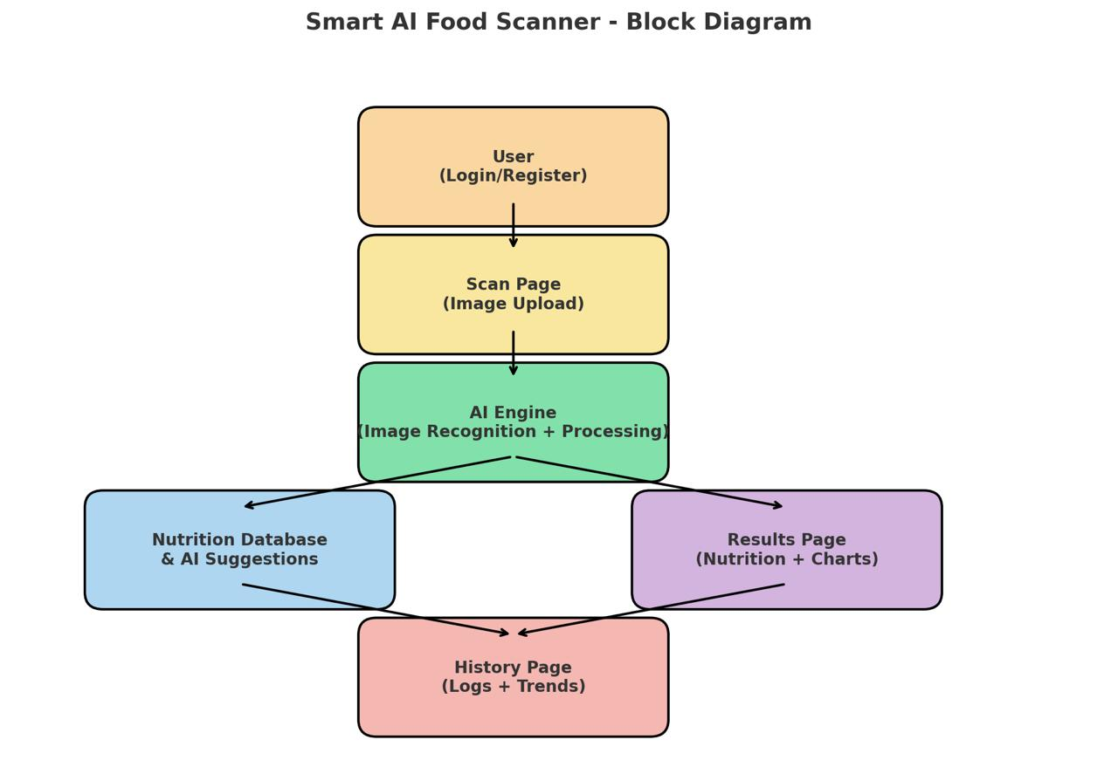
Block Diagram

Slide 22
Modules
Module 1: User Management & Backend.
Module 2: Image Capture & Preprocessing.
Module 3: AI Nutritional Analysis.
Module 4: Real-Time Feedback & Recommendations.
Module 5: Data Storage & Analytics.
Module 6: UI/UX Design.

Slide 23
Module 1
User Management & Backend
User registration and login authentication.
Profile management for dietary preferences.
Secure data handling and storage.
Admin controls for app maintenance.

Slide 24
Module 2
Image Capture & Preprocessing
Food image capture using device camera.
Image enhancement and noise reduction.
Cropping and segmentation of food items.
Preprocessing for model compatibility.

Slide 25
Module 3
AI Nutritional Analysis
Food identification using AI algorithms.
Nutrient value estimation from database.
Handling multi-item food plates.
Continuous model learning and improvement

Slide 26
Module 4
Real-Time Feedback & Recommendations.
Instant display of nutritional data.
Personalized meal suggestions.
Alerts for unhealthy food choices.
Tips for balanced nutrition

Slide 27
Module 5
Data Storage & Analytics
Logging user food consumption histor.
Data backup and security.
Generating usage statistics.
Analysis for diet trends and goals

Slide 28
Module 6
UI/UX Design
Simple and intuitive app interface.
Easy navigation for all age groups.
Accessible design for user needs.
Visual feedback and interactive elements.

Slide 29
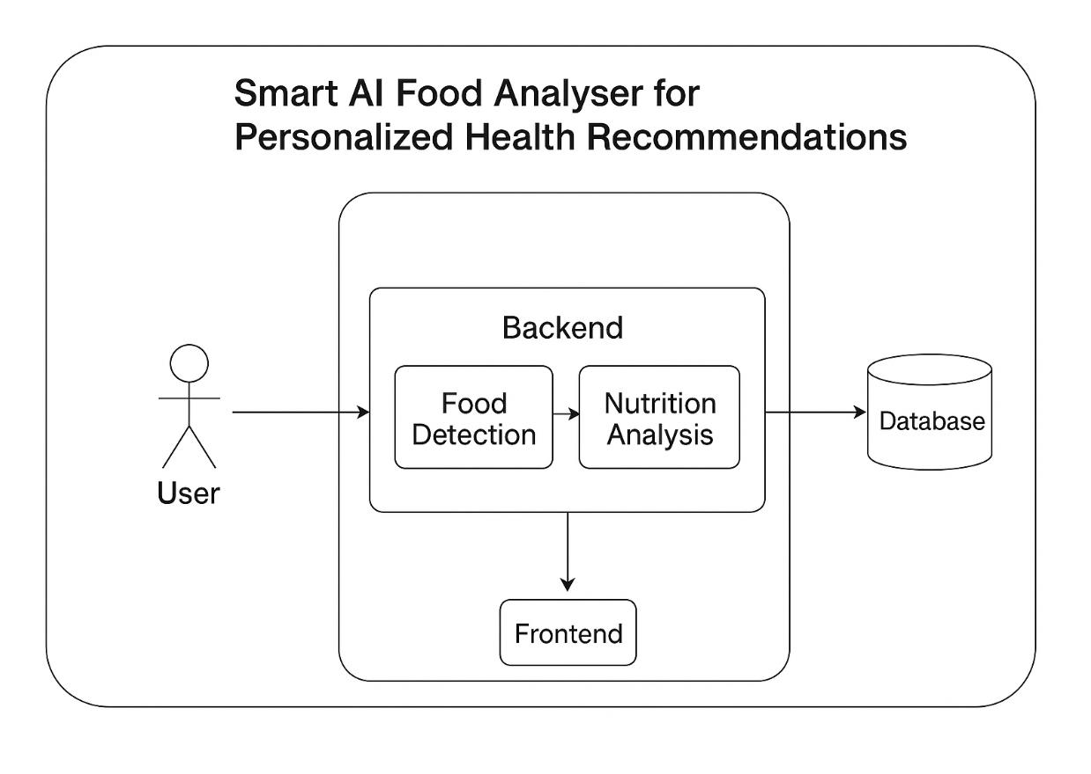
UML Diagram

Slide 30
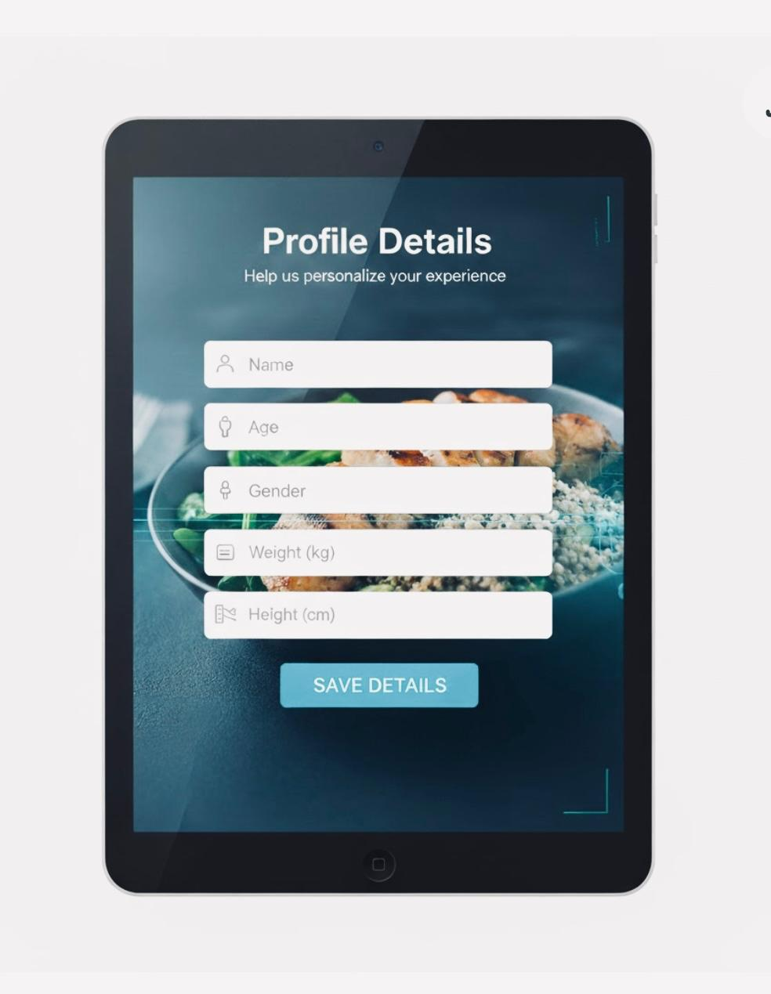
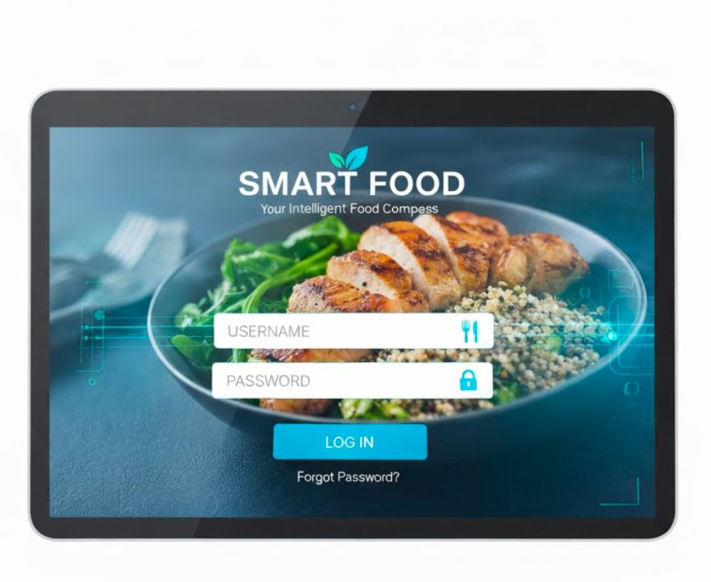
Current Progress
Currently, we have started designing the overall architecture of the Smart Food AI Scanner system and collected multiple research references related to food image analysis and nutritional estimation.
The dataset collection process has begun, including gathering sample food images for model training and testing.

Slide 31
Conclusion
•.
The Smart Food AI Scanner enables real-time nutritional analysis using AI and image recognition.
Helps users make accurate and faster dietary decisions.
Useful in healthcare, fitness, and food monitoring applications.
Provides instant insights on calories and nutrients.
Promotes a data-driven and personalized diet system.
Reduces human error in food nutrition estimation.
Encourages healthy eating habits through smart technology.

Slide 32
THANK YOU

